Slide 1


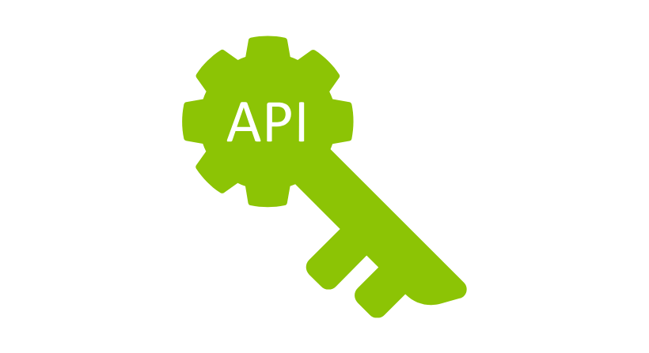
Chrome Extensions Leaking API Keys & User Data
-Presented By:-Kundan Keshav Gawande(28806)

Slide 2

Introduction — What Happened?
Explanation:
Security researchers found that some popular Chrome extensions are leaking private information.
This happens in two main ways:
Sending data without encryption (HTTP)
Putting secret API keys directly into the code (hard-coded secrets)

Slide 3


How Extensions Work
Extensions are small programs that run in your browser (like tools for VPN, password saving, etc.).
They can access websites you visit, your system info, and more.
If not built securely, they can accidentally send or expose your data.

Slide 4

Problem 1 – Using HTTP Instead of HTTPS
What’s the issue?
HTTP = No protection (like sending a postcard — anyone can read it).
HTTPS = Encrypted (like a sealed envelope).
Example:
Extensions like SEMRush Rank, MSN New Tab, and Browsec VPN send info like your device ID or uninstall logs over HTTP.
Why it’s risky:
Hackers on public Wi-Fi (like in a cafe) can intercept or change that data. This is called an AitM (Adversary-in-the-Middle) attack.

Slide 5

What is an AitM Attack?
AitM stands for "Adversary-in-the-Middle", and it's a type of cyberattack where a hacker secretly intercepts and possibly alters the communication between two parties — like between you and a website.
Imagine you’re trying to send a letter to a friend. But before the letter reaches them, someone in the middle reads it, copies it, or even changes it, then passes it along. You and your friend don’t know someone was in the middle.
That’s an Adversary-in-the-Middle attack — also known as:
MitM (Man-in-the-Middle)

Slide 6
How AitM Works (Step-by-Step)
You visit a website through your browser or an extension.
The extension sends data over an insecure connection (HTTP).
A hacker on the same network (e.g., a public Wi-Fi at a cafe or airport) is listening.
They intercept this unencrypted data using tools like:
Wireshark
mitmproxy
Bettercap
They can:
Read what’s being sent (your system info, browsing habits)
Inject fake data (redirect you to a phishing site)
Modify uninstall or tracking data

Slide 7
Problem 2 – Hard-Coded API Keys in Code
What’s the issue?
Some developers put secret API keys and passwords directly in the extension’s code.
These keys are meant to be private, like a password.
Examples:
AVG Security: Exposed Google Analytics key
Trust Wallet: Exposed crypto-related key
Screen Recorder: Exposed Amazon S3 key
Why it’s risky:
Hackers can steal these keys and:
Use them for free (increase developer’s cost)
Send fake data
Abuse cloud services (store malware or illegal content)

Slide 8
How These Leaks Happen — Step-by-Step
For HTTP Leaks:
Extension sends data to a server
If it uses HTTP, it’s not encrypted
A hacker on the same Wi-Fi can see or modify the data
For Hard-Coded Keys:
Developer writes secret key inside the code
Anyone who downloads the extension can see the code
Hacker copies the key and uses it for fraudulent activities

Slide 9

How Hackers Use This Info
With HTTP Leaks:
Steal your data (for ads or phishing)
Track your activity
Inject harmful content into websites
With Leaked API Keys:
Use your keys to:
Fake data
Inflate costs
Host illegal files
Fake crypto transactions

Slide 10

What Developers Should Do (Prevention)
Always use HTTPS – Never send data without encryption
Never hard-code secrets – Store secrets in a secure server, not inside the extension
Use secret managers – Tools that safely store passwords and keys
Audit third-party code – Tools like InboxSDK used by many can also leak secrets
Rotate API keys – Change them regularly in case of leaks

Slide 11

What Users Should Do (Protection)
Remove or avoid risky extensions
Especially if they are in the list flagged by researchers
Check permissions
Does the extension ask for too much access?
Don’t use sensitive services (like banking) on public Wi-Fi
Especially if you have many extensions installed
Use a VPN for extra encryption
Keep browser and extensions updated

Slide 12

Extension Name
SEMRush Rank
PI Rank

Slide 13


Introduction to AWS
What is Amazon Web Services (AWS)?
AWS is a cloud computing platform by Amazon.
It offers on-demand services like computing power, storage, databases, and machine learning — all over the internet.
Used by startups, enterprises, governments, and developers worldwide.

Slide 14

Key Features of AWS
☁ Scalable & Flexible – Automatically adjusts to demand.
💳 Pay-as-You-Go – Only pay for what you use.
🌍 Global Reach – 100+ availability zones worldwide.
🔒 Secure – Built-in encryption, IAM, and compliance.
🛠 Wide Service Range – Compute, storage, databases, AI, etc.

Slide 15
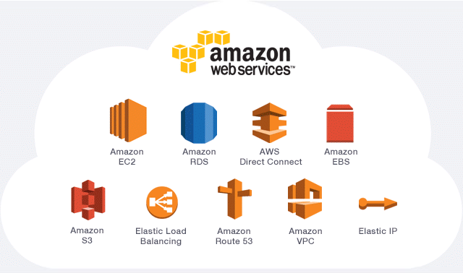
Services Of AWS

Slide 16

Creating AWS Security Groups

Slide 17
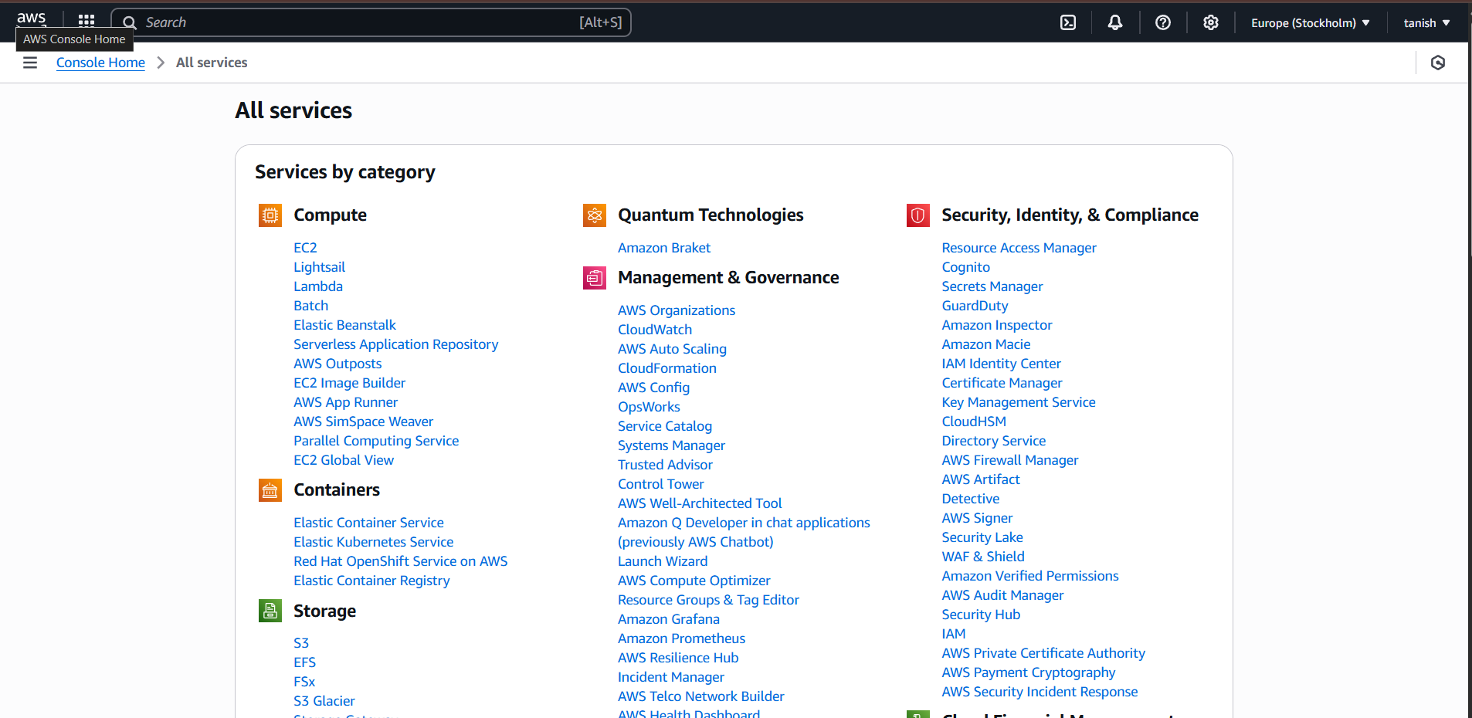
Steps to create security groups
Step 1:- Open your AWS and sign in to AWS console. From All Services Click on EC2

Slide 18
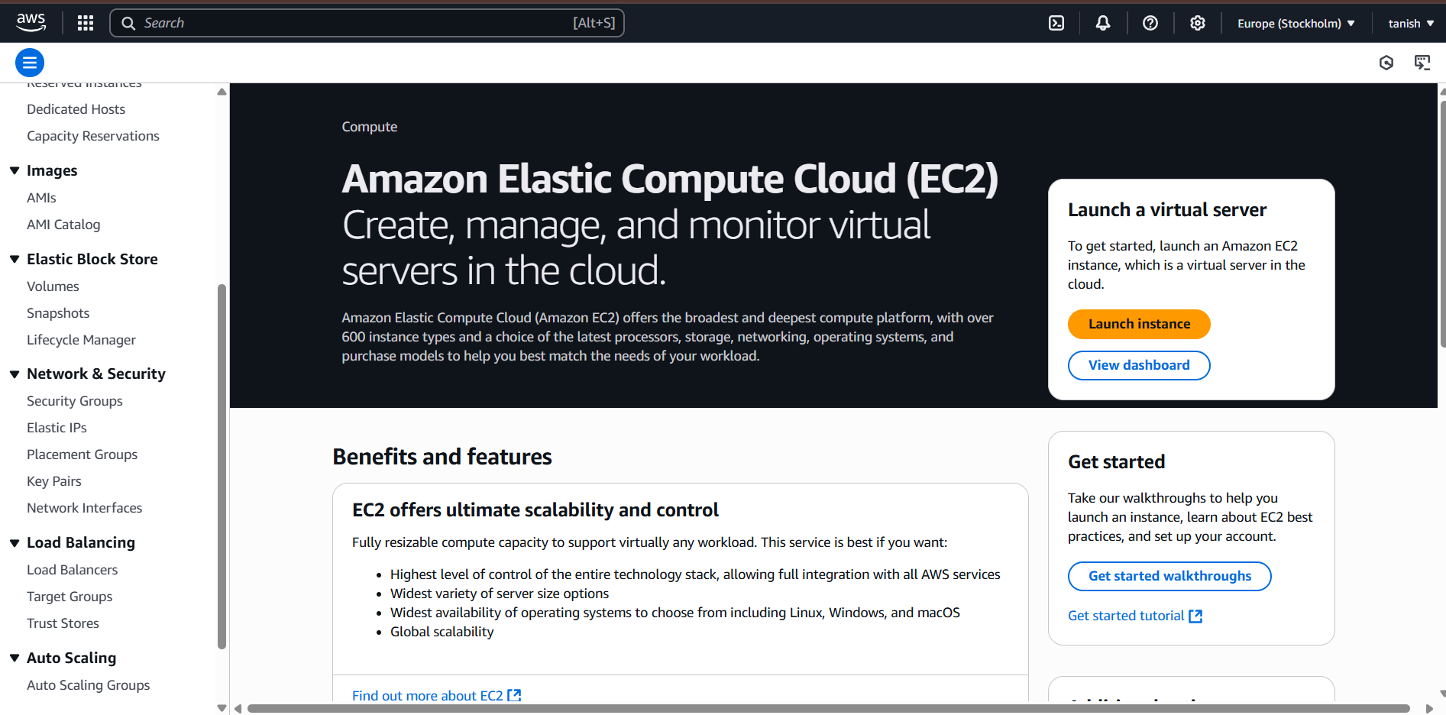
Step 2:- After clicking on EC2, select “security groups” on left hand side.

Slide 19
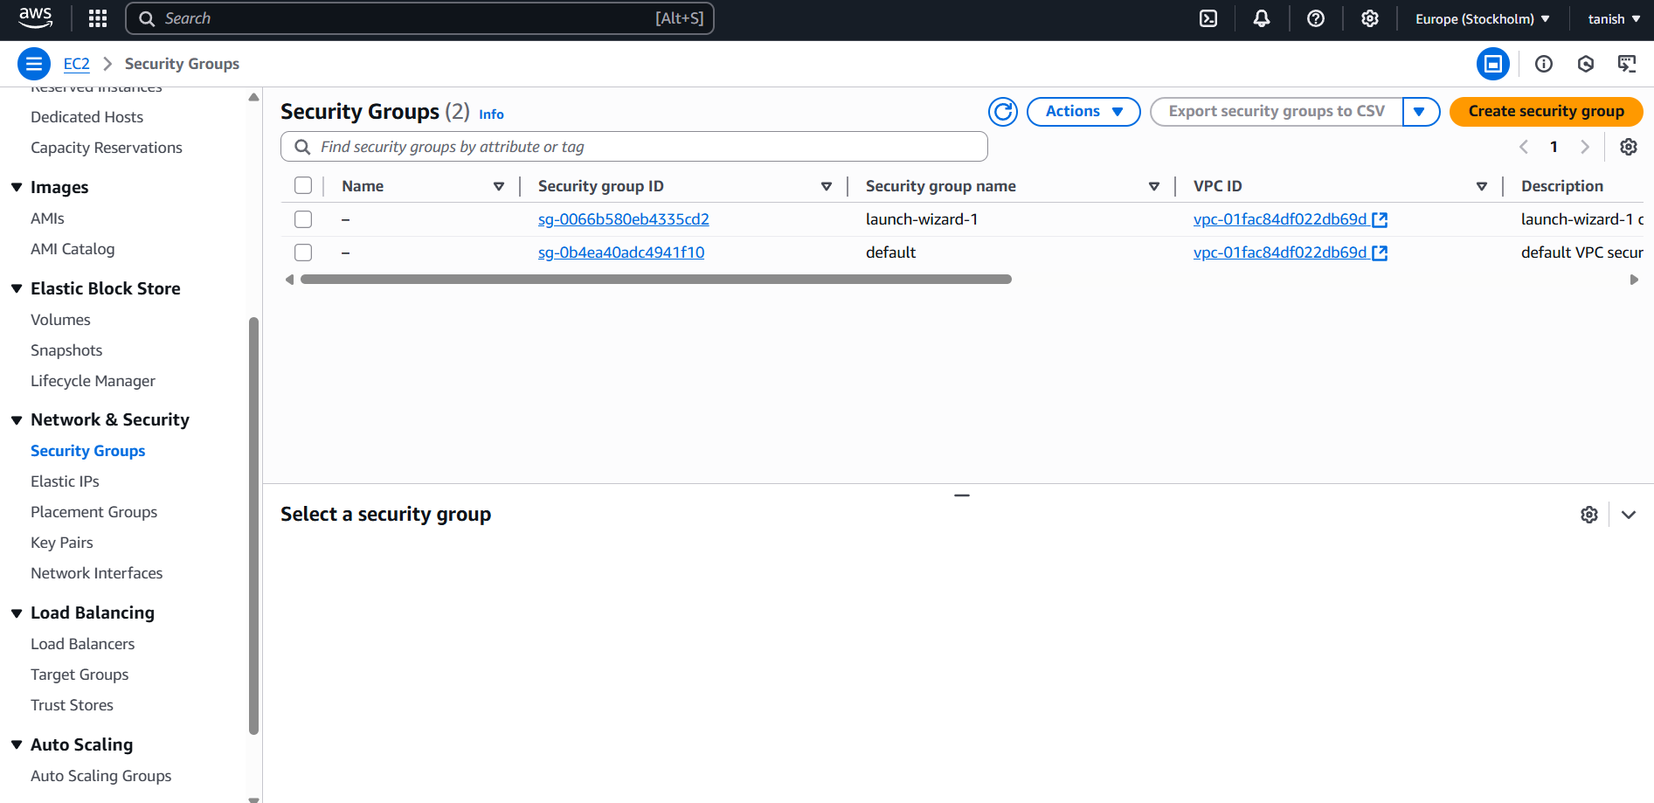
Step 3:- Click on “create security group” on top right.

Slide 20
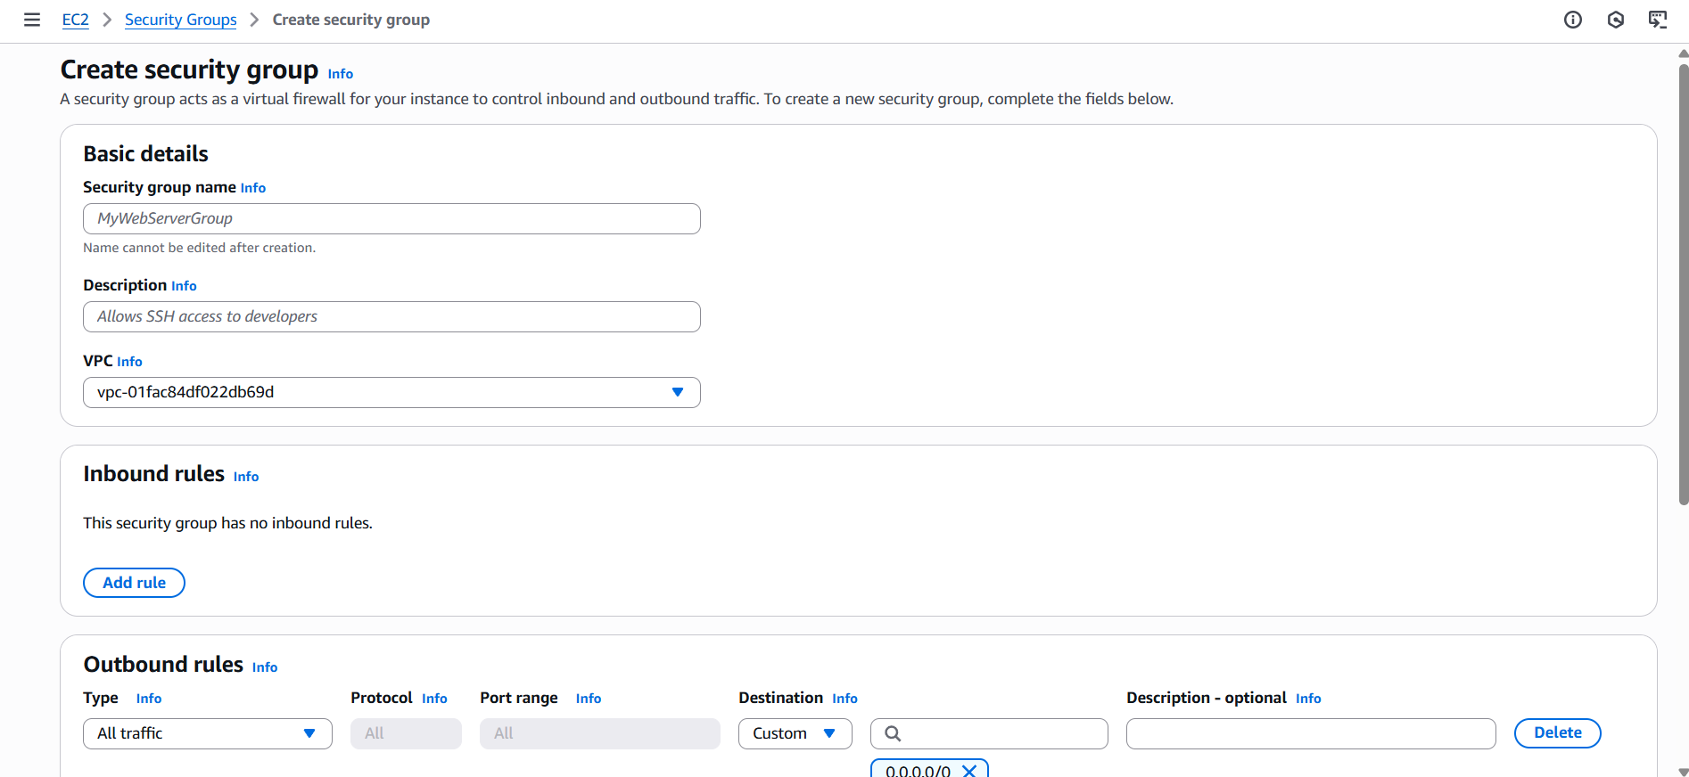
Step 4:- Fill the options and select “Add rule” in inbound rules section

Slide 21
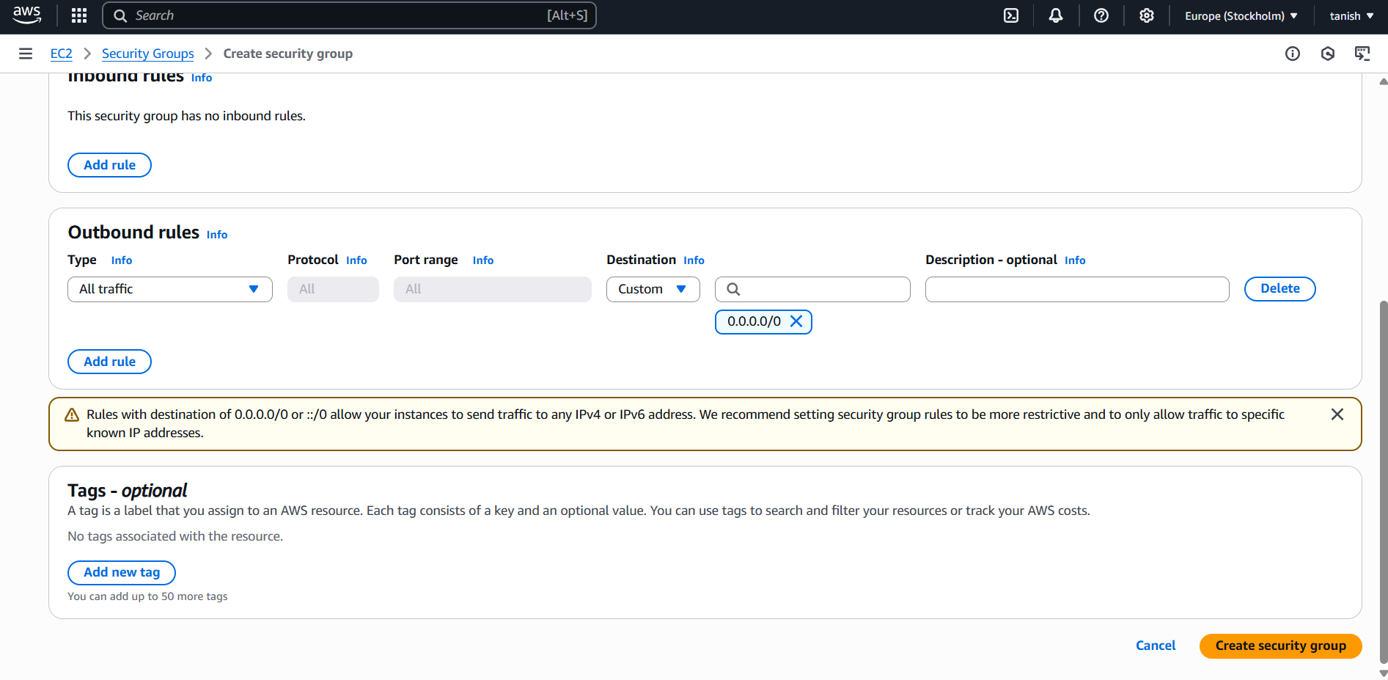
Step 5:- Select “Add rule” in outbound rules and fill other options

Slide 22
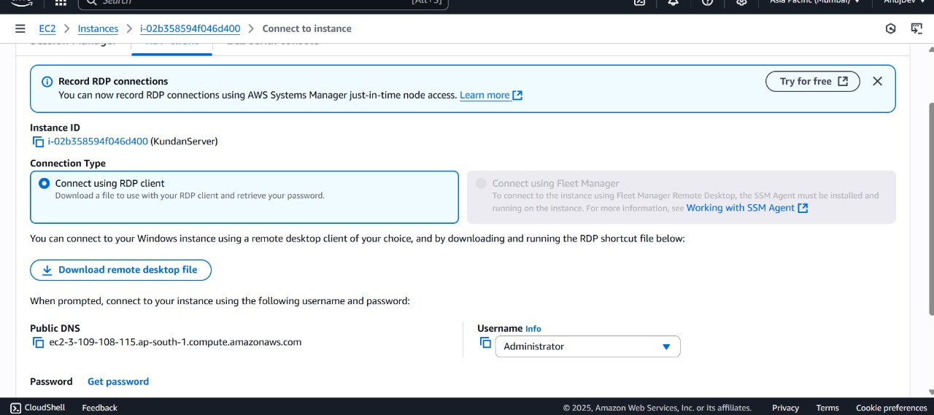

Slide 23
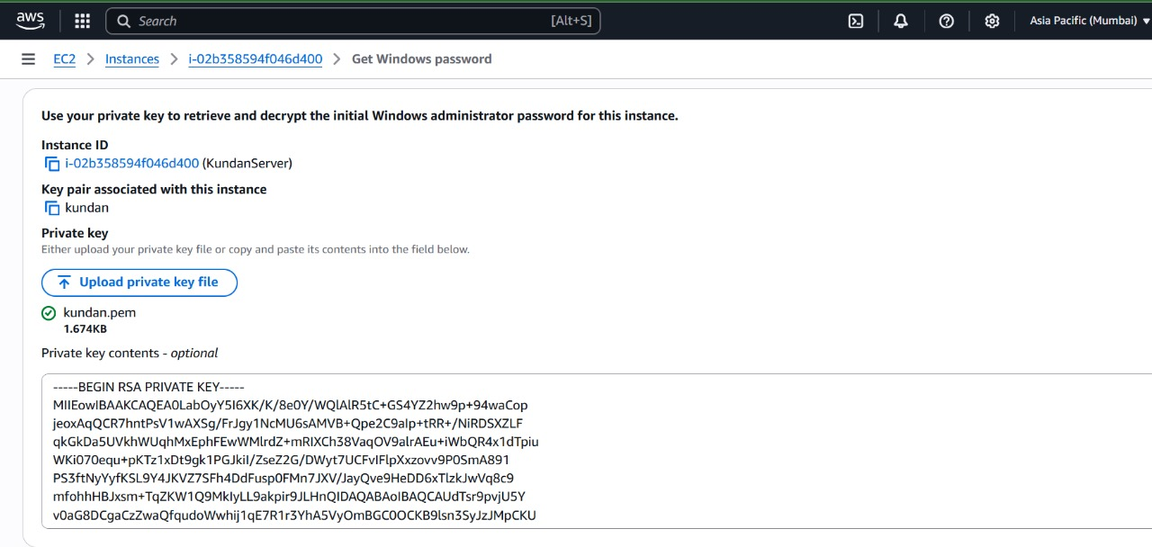

Slide 24
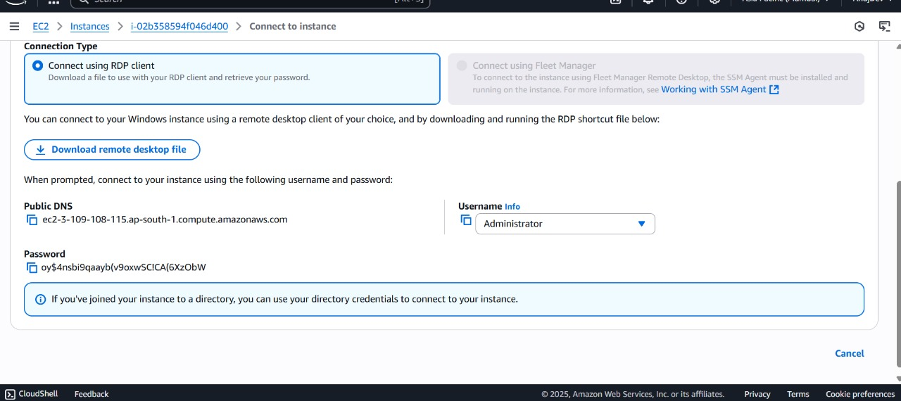

Slide 25


